Slide 1
Project 2: Financial accounting
Fixed asset analysis

Slide 2
Hula Hut Burger dataset
Data set has 1,500 records
Anonymized and modified data for a tax client at a public accounting firm
All project materials are at iteachaccounting.com

Slide 3
Hula Hut Burger dataset
Jim Nelson, owner of Hula Hut Burger has contacted your accounting firm to review his fixed asset records. Hula Hut Burger is the home of the “tastiest burger in the world” and specializes on serving all-organic beef and locally sourced food with a Hawaiian flair. The company has restaurants throughout the United States and divides its reporting into six regions (South, Mid-Atlantic, Southwest, Northeast, West, and Midwest).
Jim has provided you with a spreadsheet containing the company’s fixed asset data and has asked that your firm prepare a fixed asset schedule and answer various questions concerning the company’s fixed assets.

Slide 4
Hula Hut Burger dataset
In addition to the fixed asset data, Jim included the following information from the company’s fixed asset policies and procedures manual.
Fixed asset categories are defined as follows:
Land Vacant land parcels purchased for building sites, parking lots, or other purposes.
Land Improvements Site improvements (other than buildings) such as fencing and parking lots.
Buildings Permanent structures (including permanently attached fixtures).
Equipment Self-explanatory.
Furniture Self-explanatory.
Note: This data analytics activity uses an anonymized fixed asset record from a small company for the years of 1991 – 2014 and contains approximately 1,500 records.

Slide 5
Learning objectives
Create a pivot table in Excel
Format a pivot table
Apply filters to a pivot table
Create sum columns in a pivot table
Create a calculated field
Use the slicer tool in a pivot table
Analyze data for errors
Use the timeline tool in a pivot table
Create a pivot chart in Excel

Slide 6
Hula Hut Burger data dictionary
RegionalArea: Indicates the regional location of the fixed asset.
AssetID: This field is a sequential number assigned at purchase. This is a unique identified.
AssetCategory: Indicates the fixed asset category.
InSvcDate: This is the date the asset was put into service.
Cost: The purchase price of the asset.
SalvageValue: The salvage value assigned by the company.
DeprMeth: The depreciation method used for the asset. NoDep indicates that no depreciation is being calculated. SL indicates the asset is being depreciated using the straight-line convention.
Useful Life: The useful life assigned by the company.
BegAccumDepr: Beginning accumulated depreciation as of 1/1/2014.
CurrentYearDepr: Current year depreciation for 2014.

Slide 7
General instructions
For each of the requirements, create a new pivot table in a new worksheet. Name each new worksheet as “Req 1,” “Req 2,” etc. Format the dollar amounts in each pivot table or pivot chart using the accounting format with zero decimal places. Format non-currency numbers in each pivot table or pivot chart using the number format with zero decimal places.
Notes:
In general, for each of the requirements in this activity, create a new pivot table in a new worksheet. Name each new worksheet as “Req 1,” “Req 2,” etc. Format the dollar amounts in each pivot table or pivot chart using the accounting format with zero decimal places. Format non-currency numbers in each pivot table or pivot chart using the number format with zero decimal places.

Slide 8
Requirement 1
Prepare a fixed asset schedule that contains the totals for cost, beginning accumulated depreciation, current year depreciation, ending accumulated depreciation, and ending book value by regional areas. (Hint: Create a calculated field for Ending Accumulated Depreciation and Ending Book Value.) What is the total ending book value for the Northeast region? How much depreciation was taken during the year for the entire company?

Slide 9
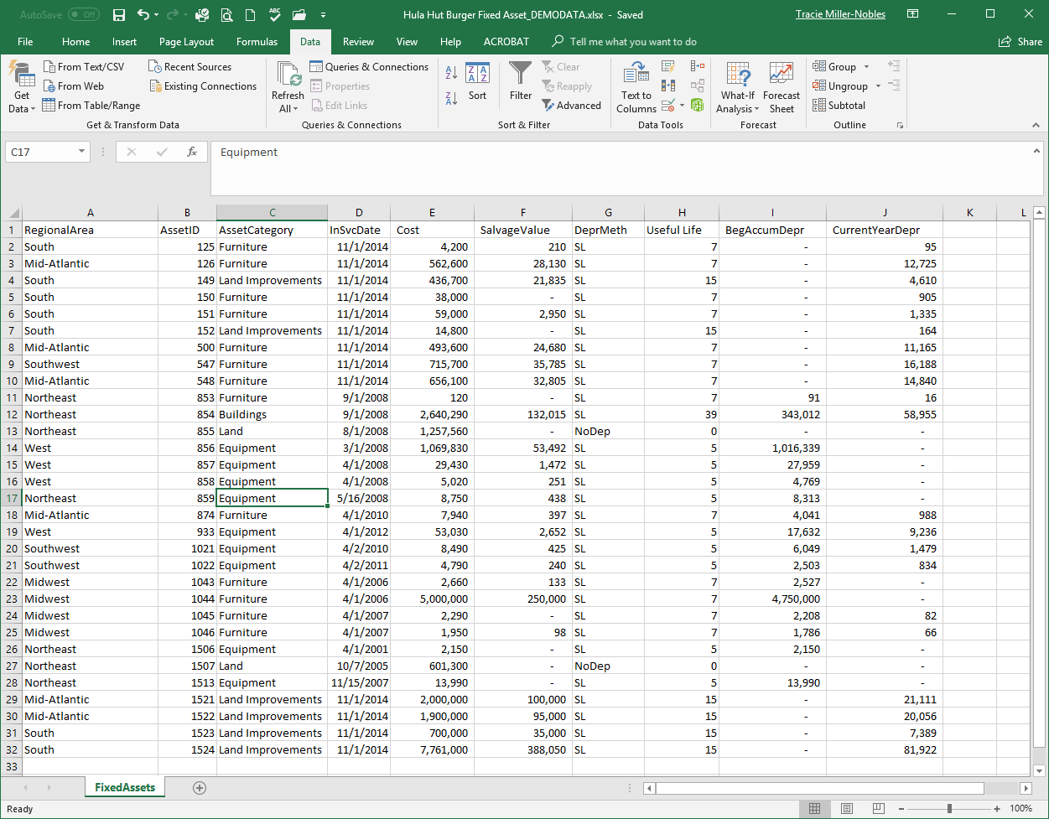
Start by opening Excel workbook

Slide 10
Start by opening Excel workbook
Req 1: Fixed Asset Schedule
#1: Click anywhere in the data in the Data worksheet

Slide 11
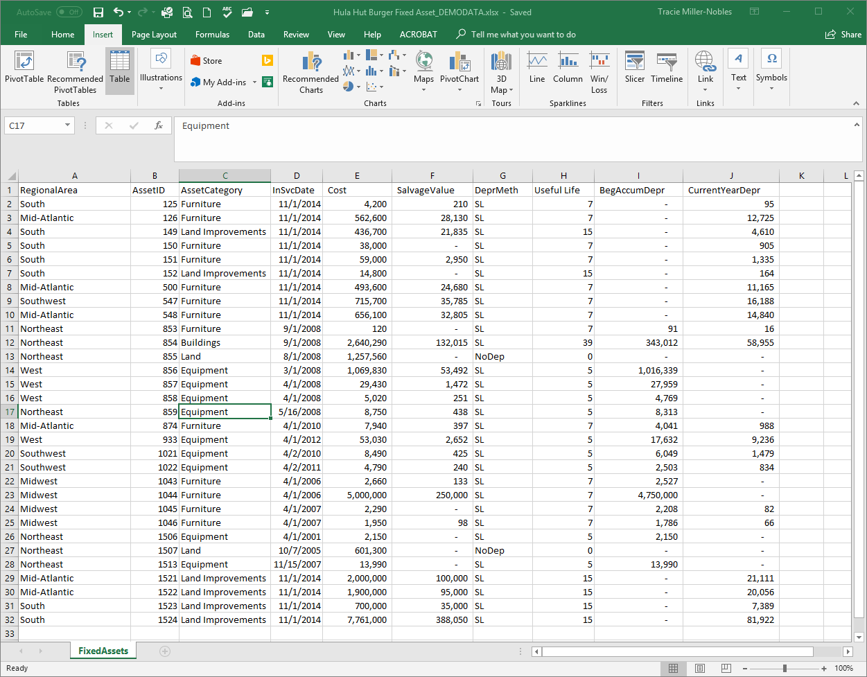
Start by opening Excel workbook
Req 1: Fixed Asset Schedule
#2: Click on Insert tab

Slide 12
Start by opening Excel workbook
Req 1: Fixed Asset Schedule
#3: Click on PivotTable

Slide 13
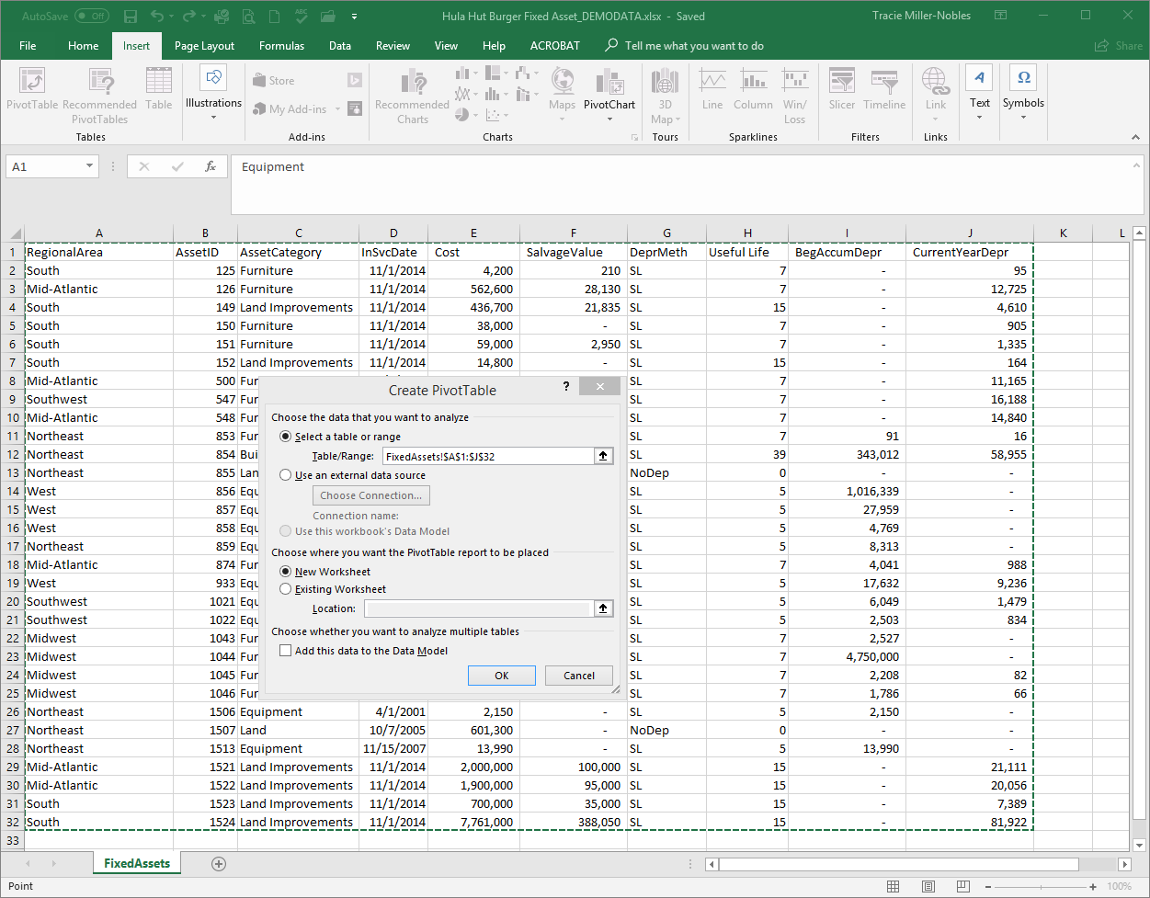
Req 1: Fixed Asset Schedule
#4: Click on OK (use defaults)

Slide 14
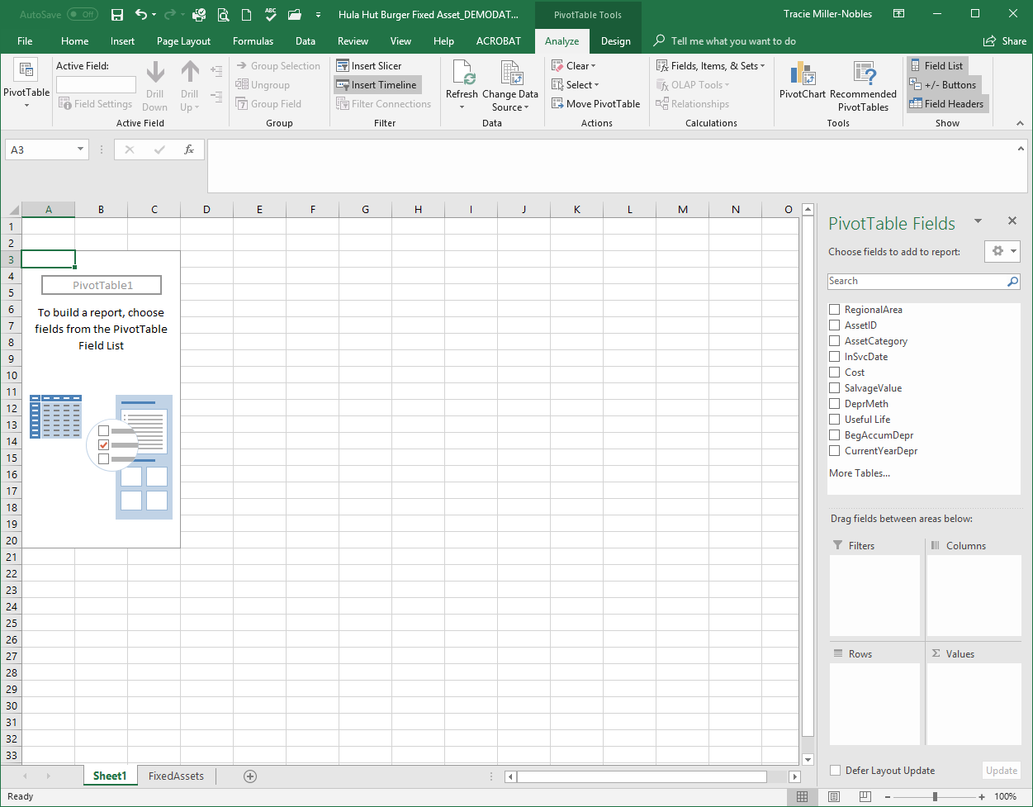
Req 1: Fixed Asset Schedule
#5: Right-click the worksheet name to rename it as “Req 1”

Slide 15
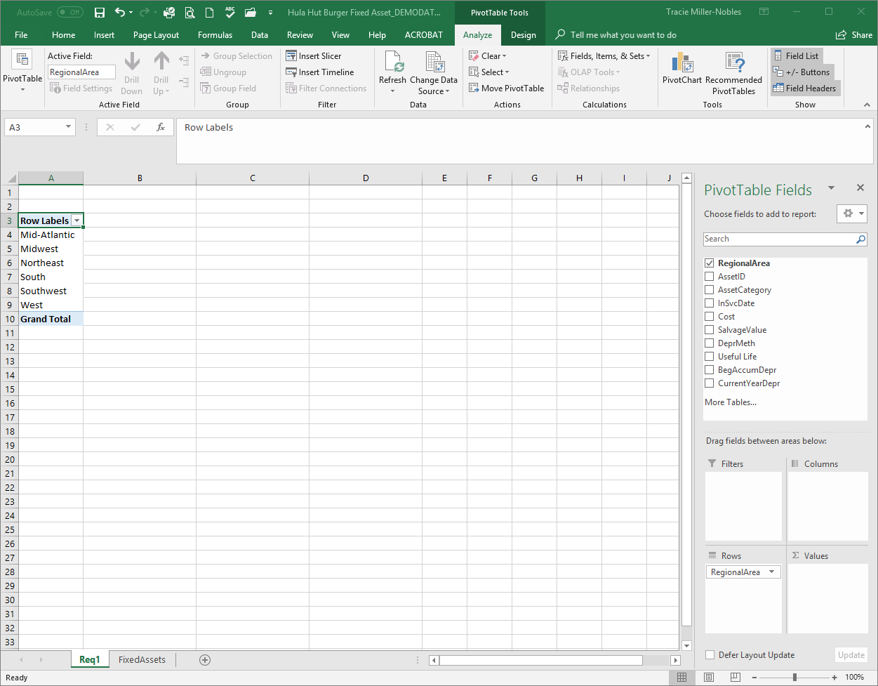
Req 1: Fixed Asset Schedule
#6: Drag “RegionalArea” in the PivotTable Fields panel down to the Rows box

Slide 16
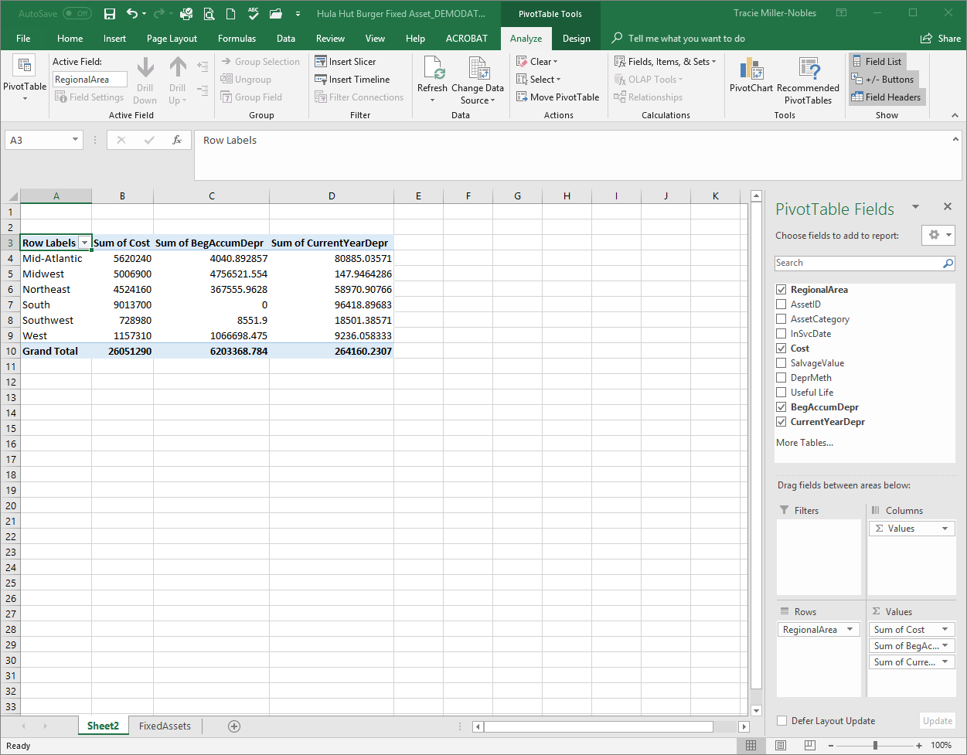
Req 1: Fixed Asset Schedule
#7: Drag “ Cost”, “BegAccumDepr” and “CurrentYearDepr” in the PivotTable Fields panel down to the Values box

Slide 17
Req 1: Fixed Asset Schedule
#8: Click Fields, Items & Sets and then Calculated Field

Slide 18
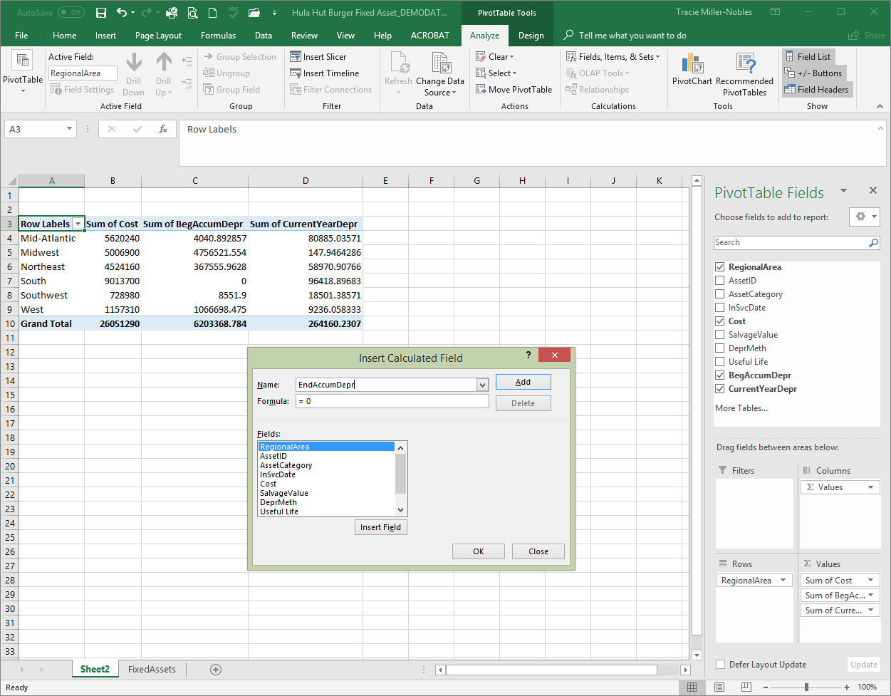
Req 1: Fixed Asset Schedule
#9: Name the Field

Slide 19
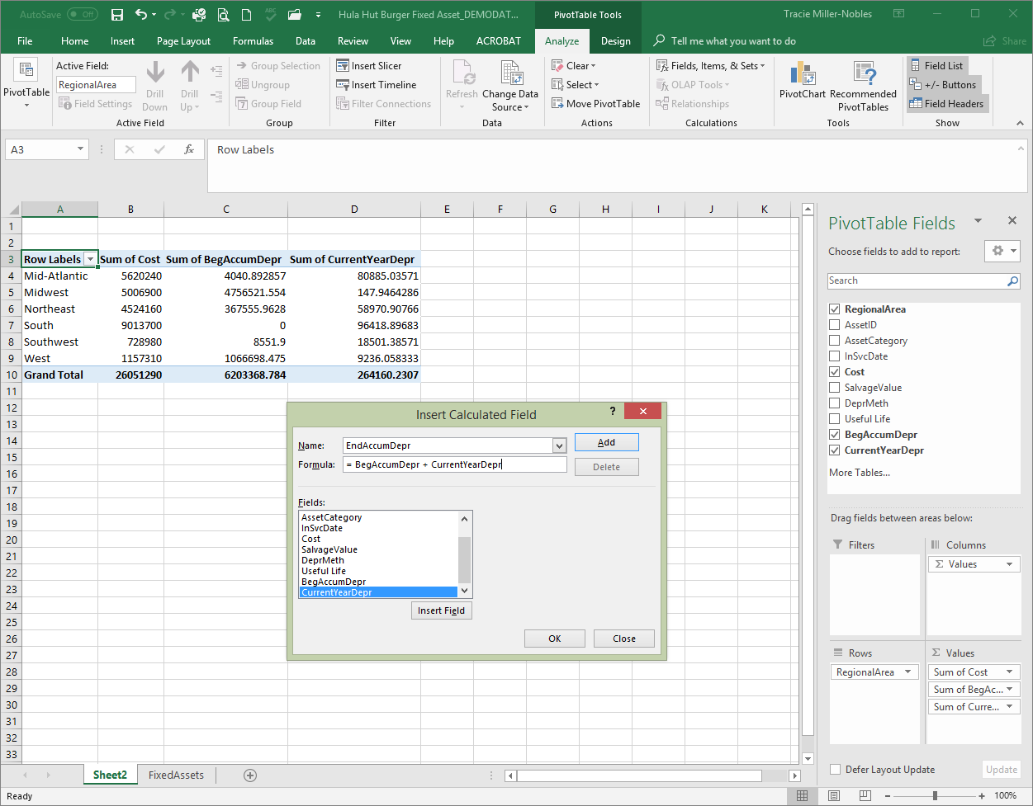
Req 1: Fixed Asset Schedule
#10: Enter formula by selecting “BegAccumDepr” and click Insert Field. Type “+”. Select “CurrentYearDepr” and click Insert Field. Click OK.

Slide 20
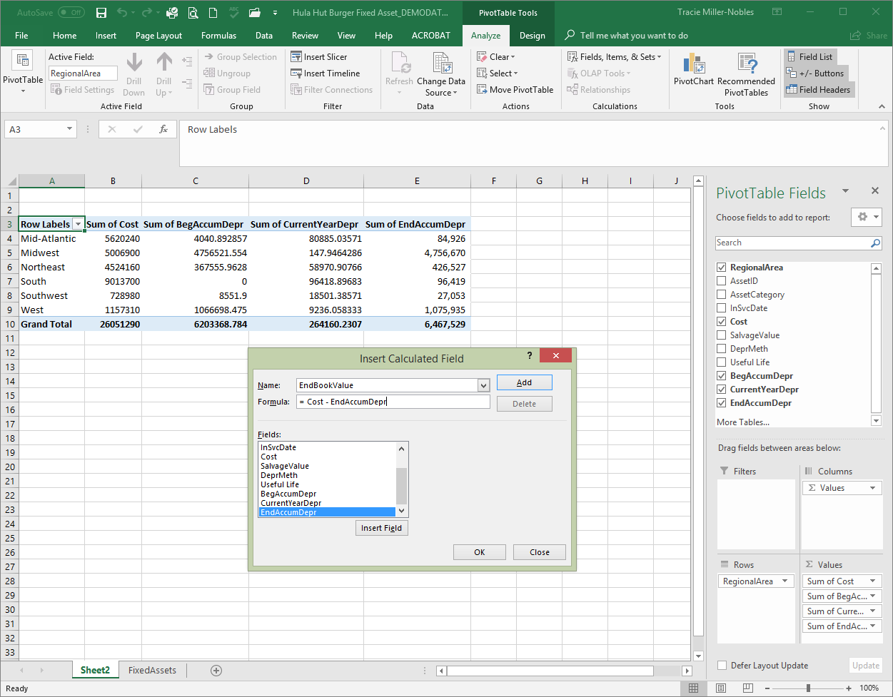
Req 1: Fixed Asset Schedule
#11: Create a calculated field for Ending Book Value.

Slide 21
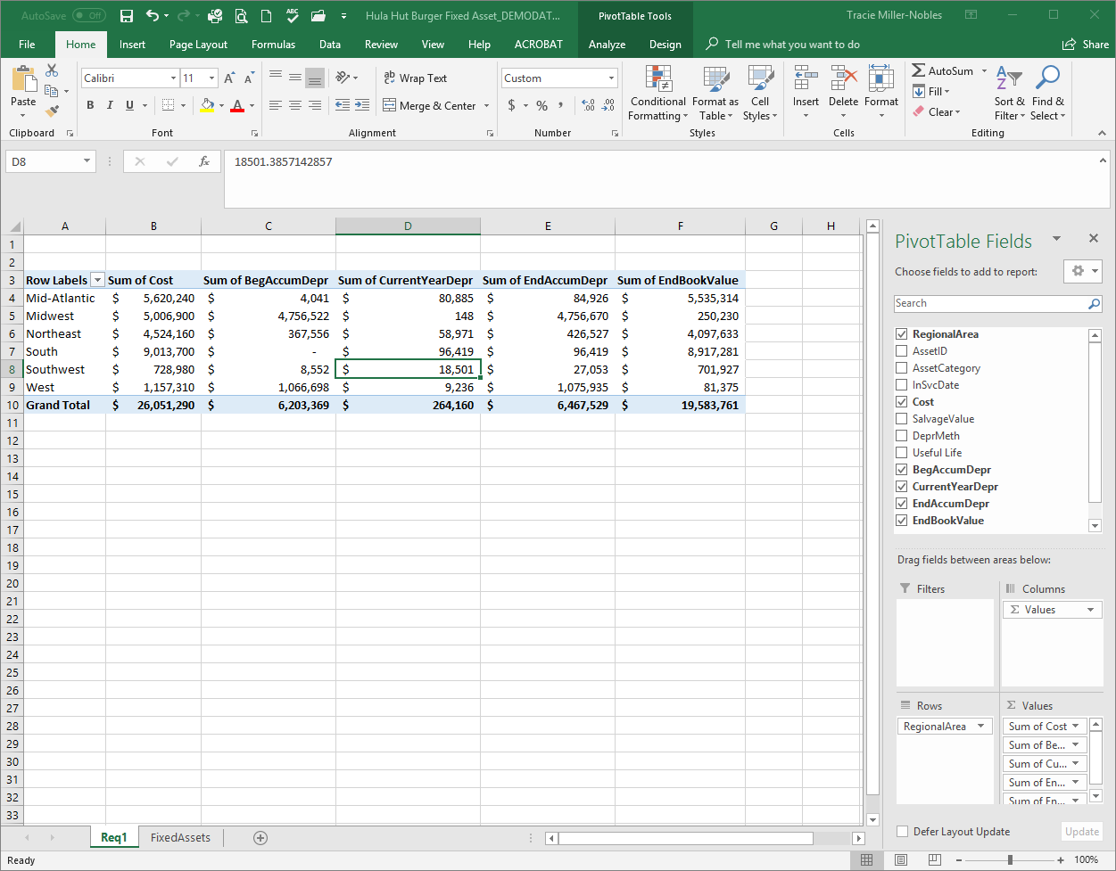
Req 1: Fixed Asset Schedule
#12: Format the dollar amounts using the accounting format with zero decimal places.

Slide 22
Req 1: Fixed Asset Schedule
Answer1.1: Total ending book value for Northeast region.
Answer1.2: Depreciation taken during the year entire company.

Slide 23
Requirement 2
Which region(s) does not have land?

Slide 24
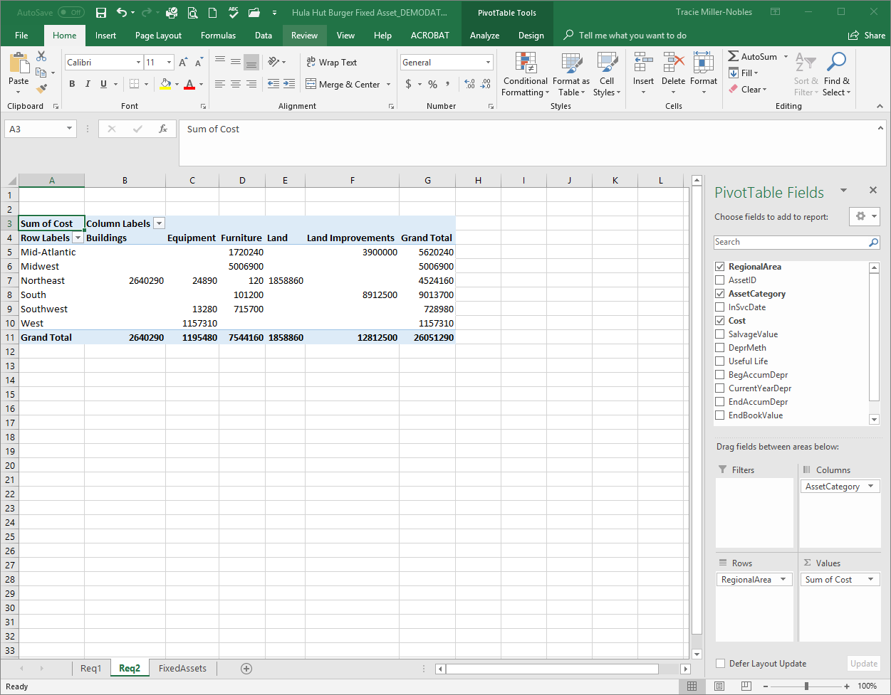
Req 2: Which regions(s) does not have land?
#1: Create a pivot table that shows “RegionalArea” as rows and “AssetCategory” as columns. Drag “Cost” down to Values.

Slide 25
Req 2: Which regions(s) does not have land?
#2: This pivot table easily identifies which regions don’t have land.

Slide 26
Req 2: Which regions(s) does not have land?
#3: You could also sort by using the Column Labels drop down arrow.

Slide 27
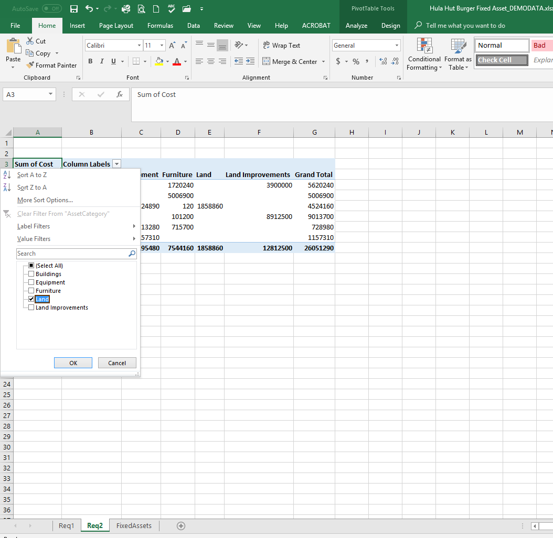
Req 2: Which regions(s) does not have land?
#3: Click the arrow and select only “Land”. Click OK.

Slide 28
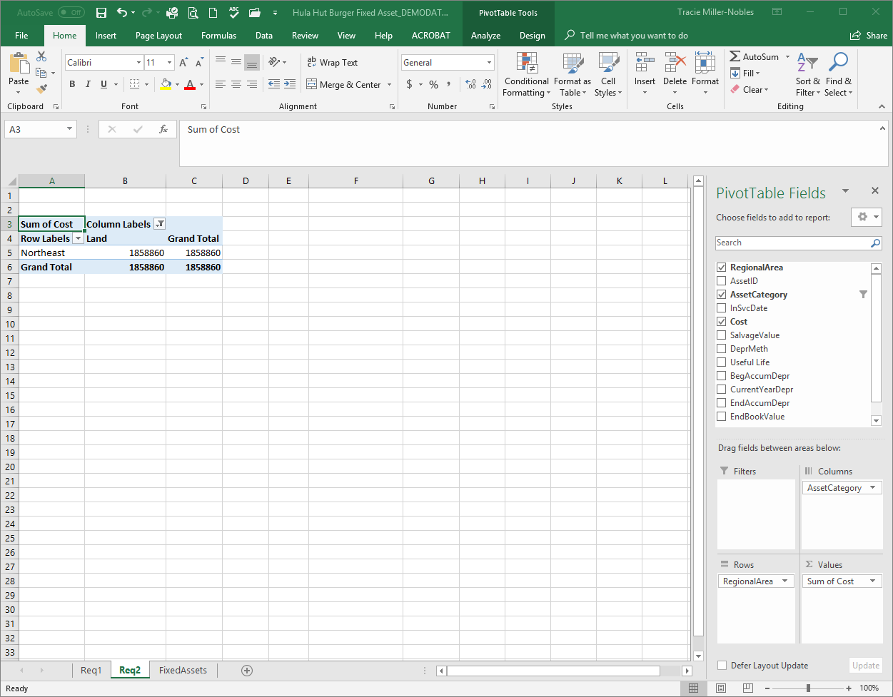
Req 2: Which regions(s) does not have land?
Ans2: This shows that only the Northeast has land.

Slide 29
Requirement 3
Jim is concerned that there might be some errors in the data for the Northeast. Prepare a fixed asset schedule (similar to requirement 1) for the Northeast by asset category. Identify the asset ID which has the error and explain the error involved. (Hint: Use the slicer. Don’t worry about checking any calculations.)

Slide 30
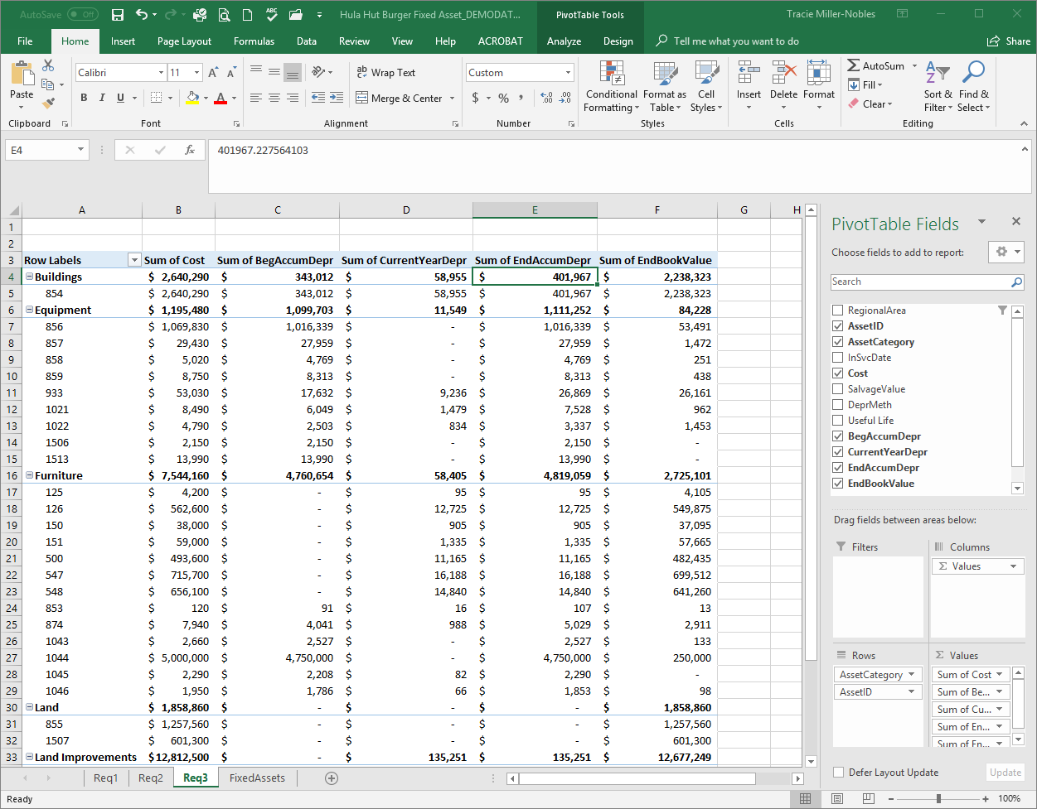
Req 3: Fixed Asset Schedule for Northeast by asset category.
#1: Begin by creating a fixed asset schedule similar to requirement 1. Use “AssetCategory” and “AssetID” for rows.

Slide 31
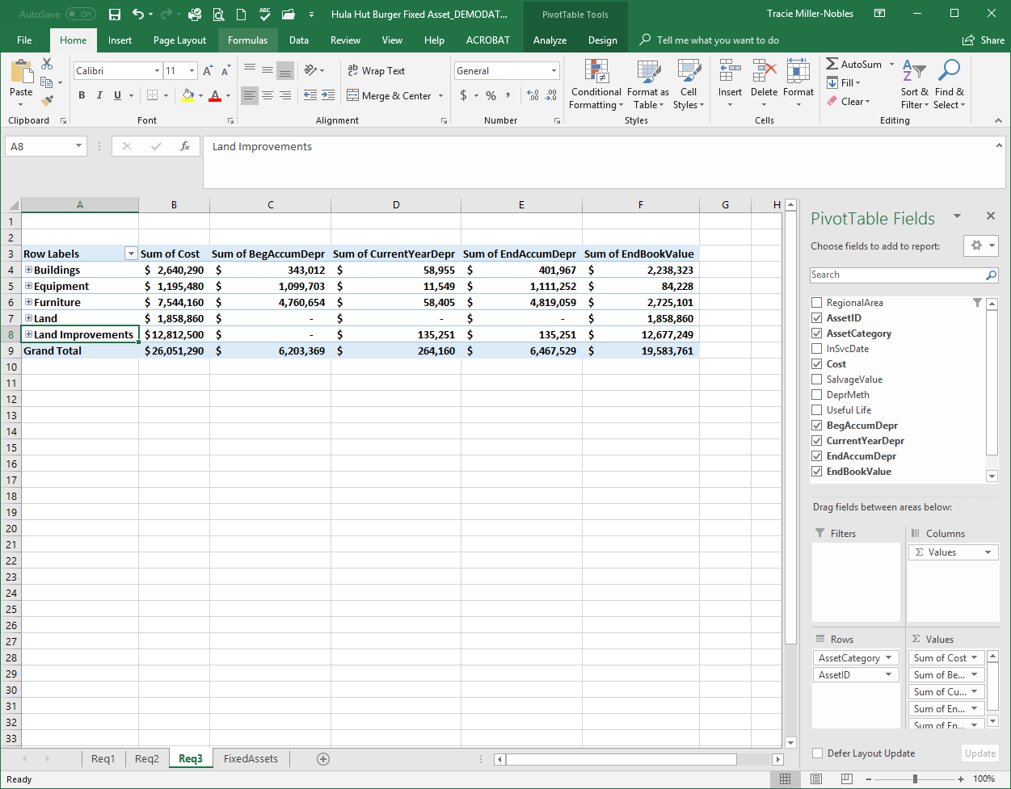
Req 3: Fixed Asset Schedule for Northeast by asset category.
#2: To not show the Asset IDs, click the “+” sign.

Slide 32
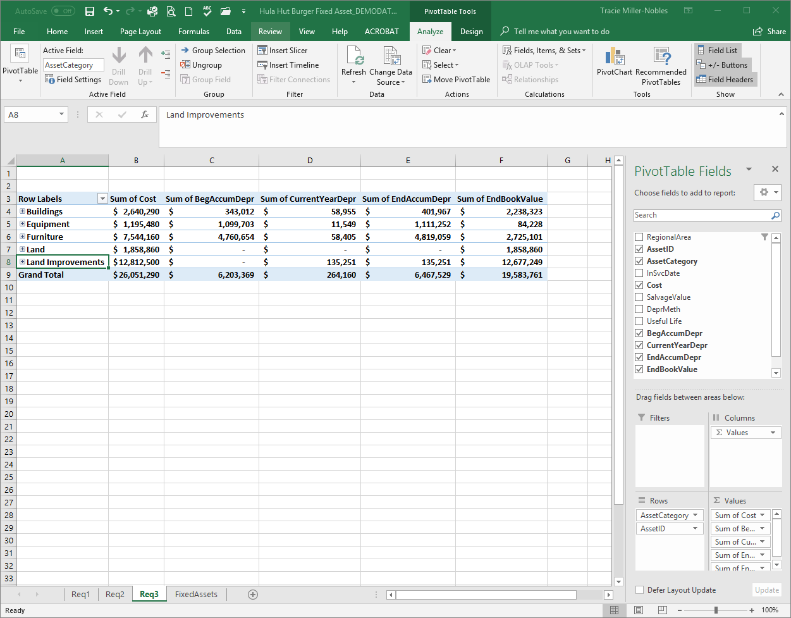
Req 3: Fixed Asset Schedule for Northeast by asset category.
#3: On the Analyze tab, click Insert Slicer

Slide 33
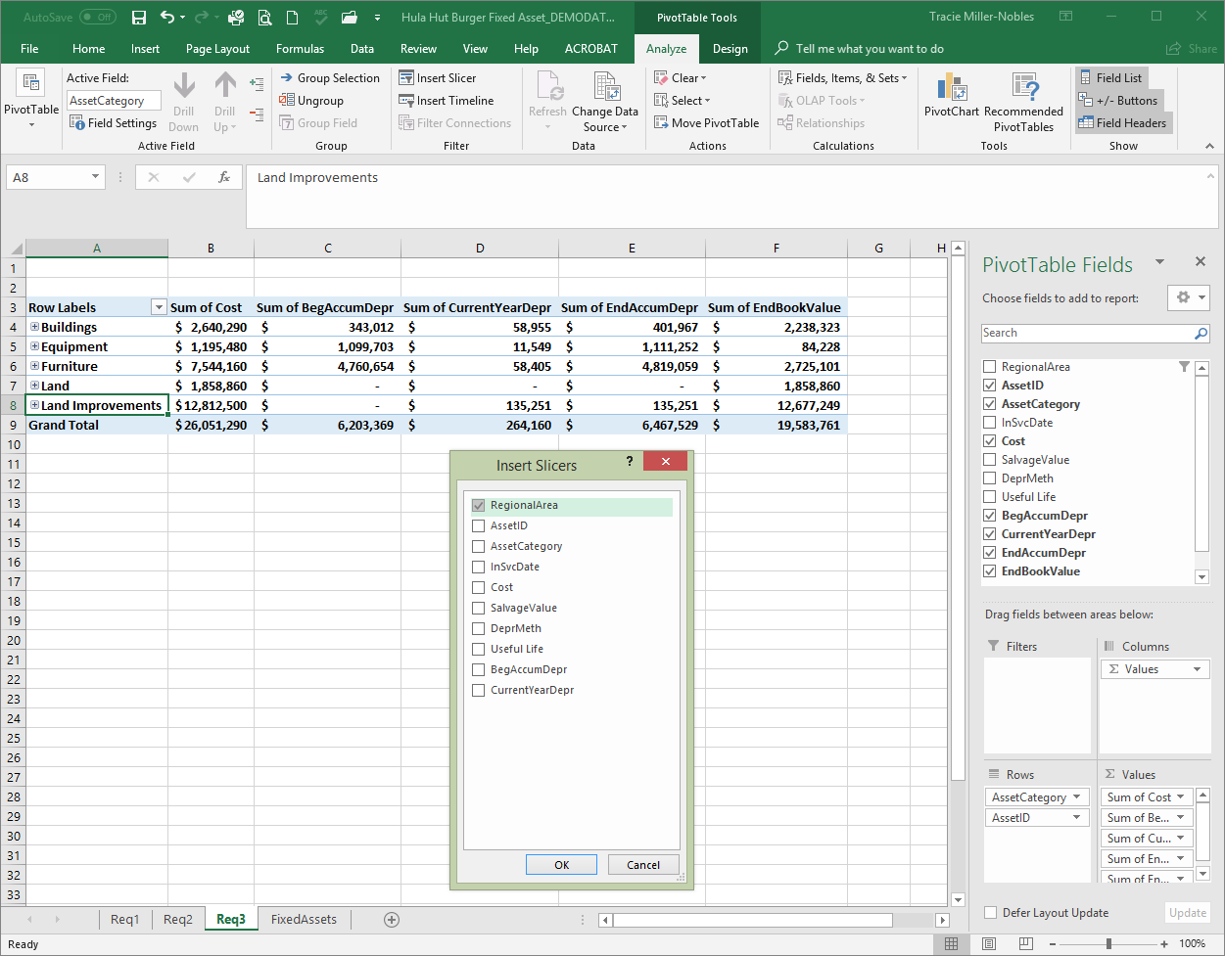
Req 3: Fixed Asset Schedule for Northeast by asset category.
#4: Select RegionalArea and then OK

Slide 34
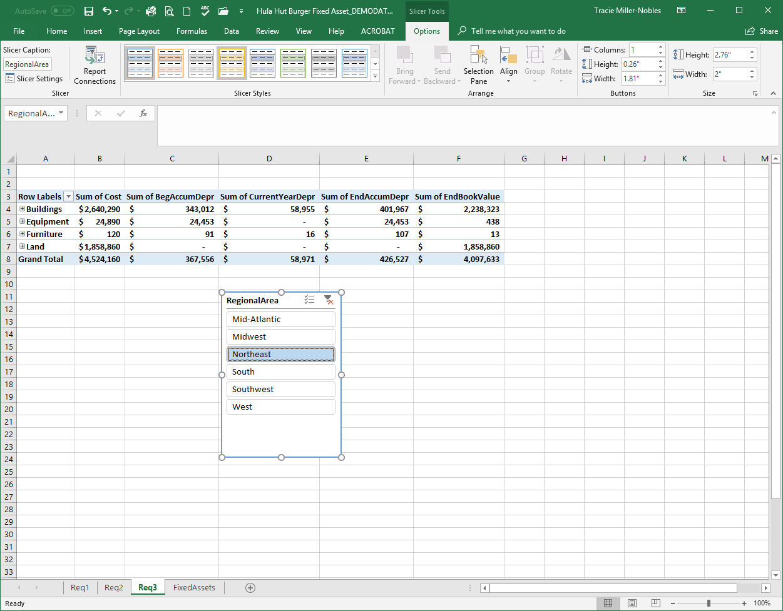
Req 3: Fixed Asset Schedule for Northeast by asset category.
#5: Select Northeast to show only
NE region

Slide 35
Req 3: Fixed Asset Schedule for Northeast by asset category.
#6: Drill down to find AssetID that has error

Slide 36
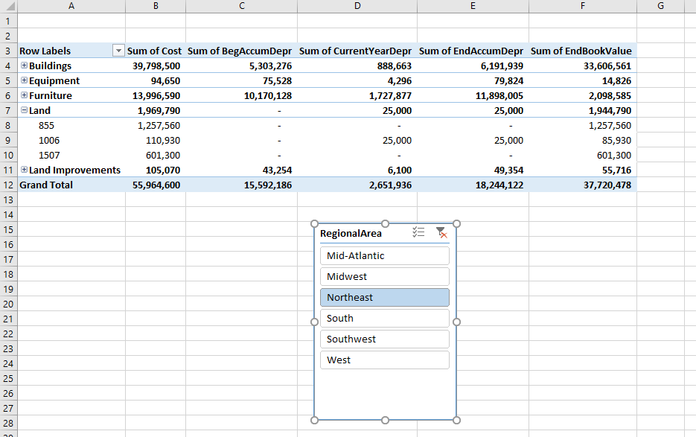
Req 3: Fixed Asset Schedule for Northeast by asset category.

Slide 37
Requirement 4
What is the total cost of assets purchased by asset category in 2014? (Hint: Use the Timeline Tool)

Slide 38
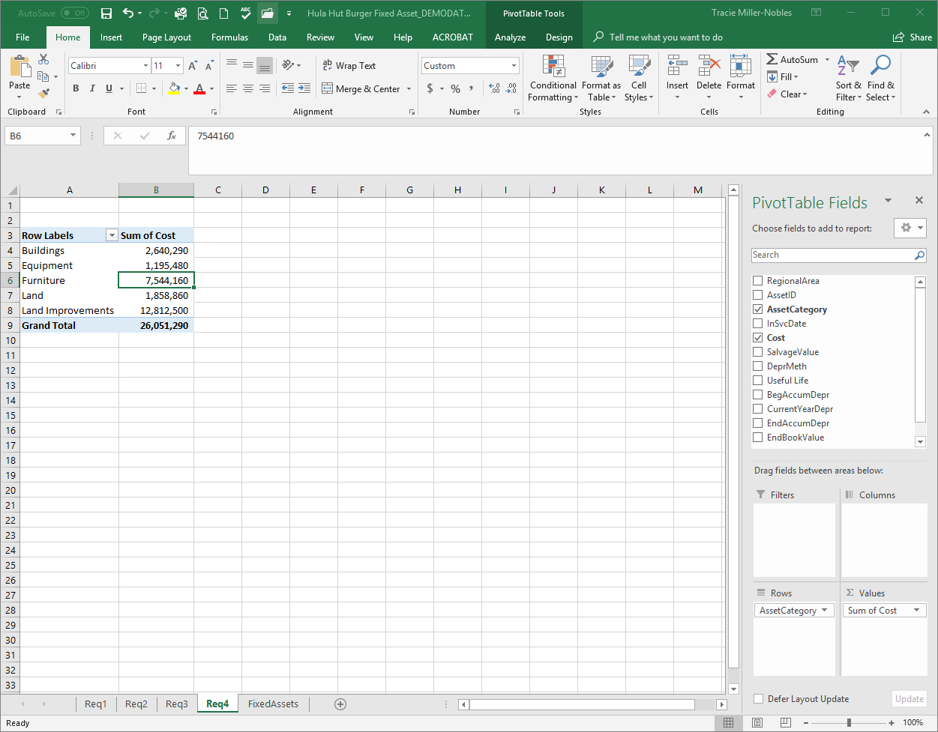
Req 4: Total cost of assets purchased by asset category in 2014
#1: Begin by creating a pivot table showing the total cost by asset category.

Slide 39
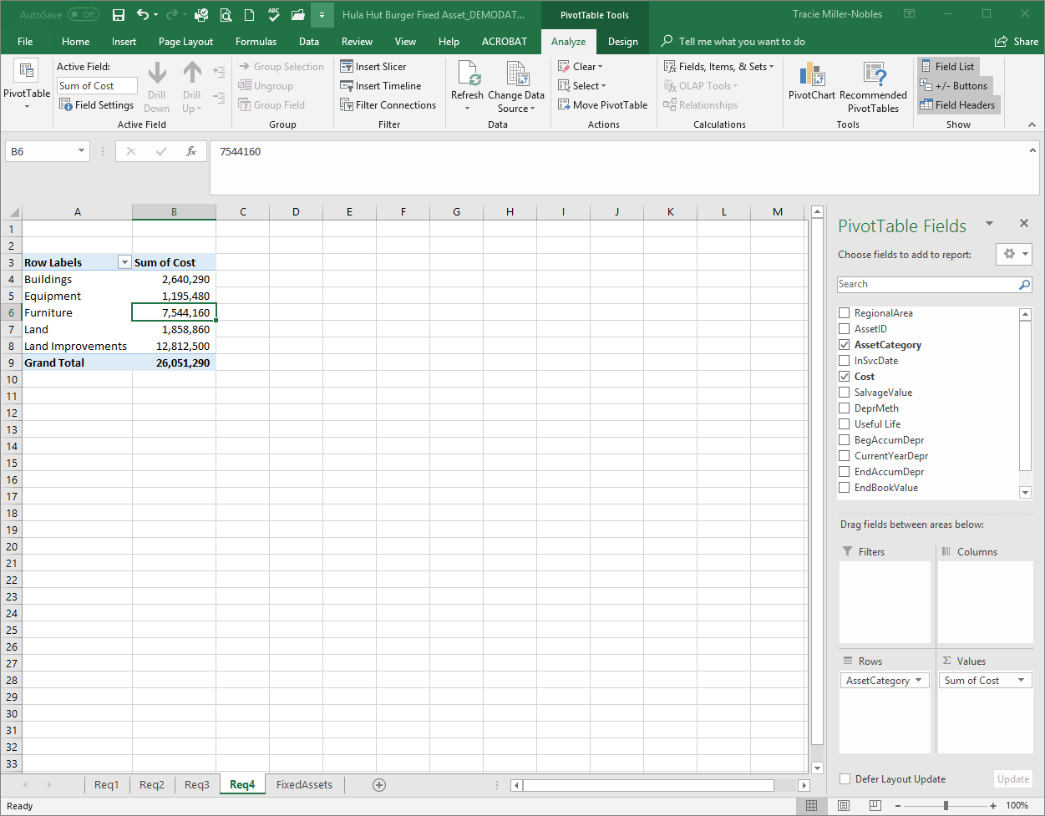
Req 4: Total cost of assets purchased by asset category in 2014
#2: On the analyze tab, click Insert Timeline

Slide 40
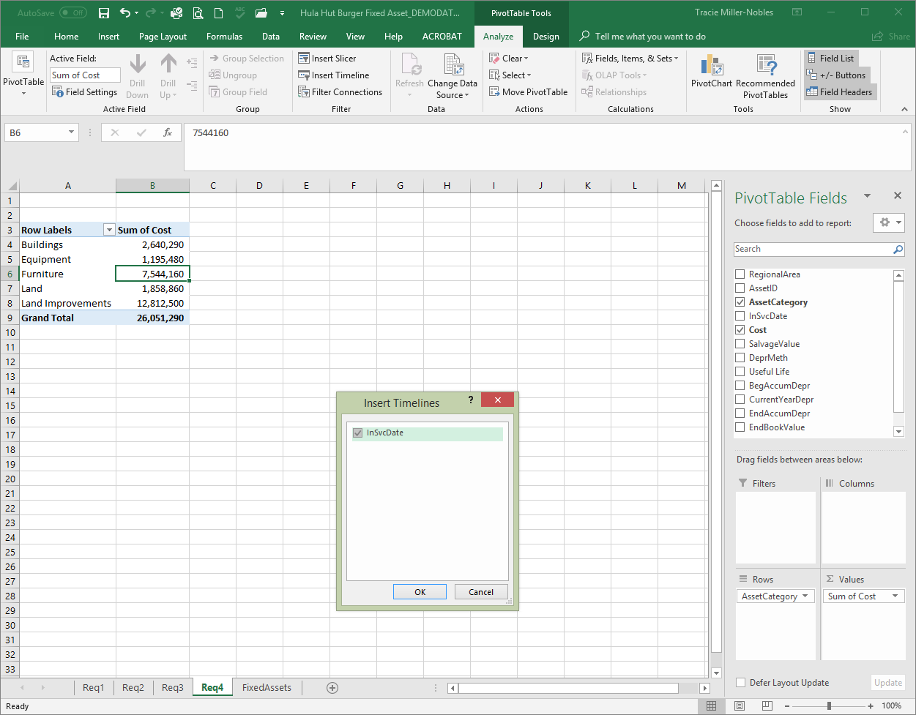
Req 4: Total cost of assets purchased by asset category in 2014
#3: Select InSvcDate and then OK

Slide 41
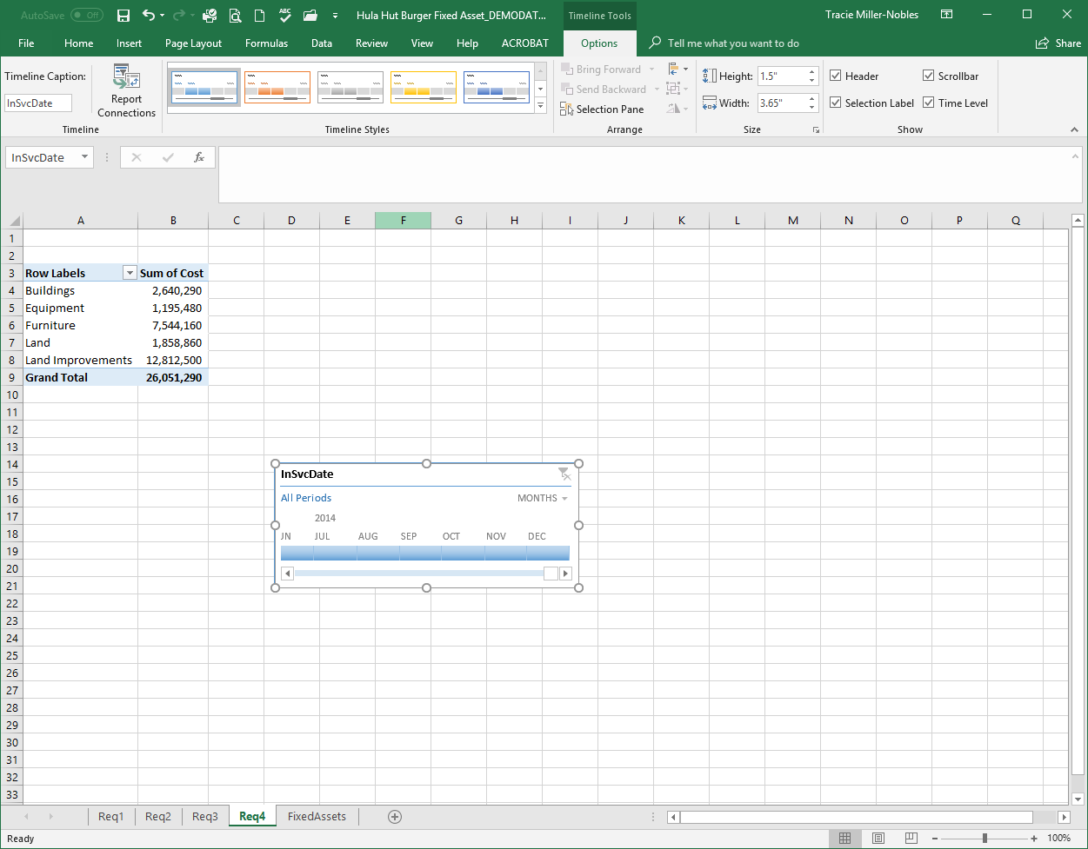
Req 4: Total cost of assets purchased by asset category in 2014
#4: The default is months. Change to years by clicking on the down arrow and selecting years.

Slide 42
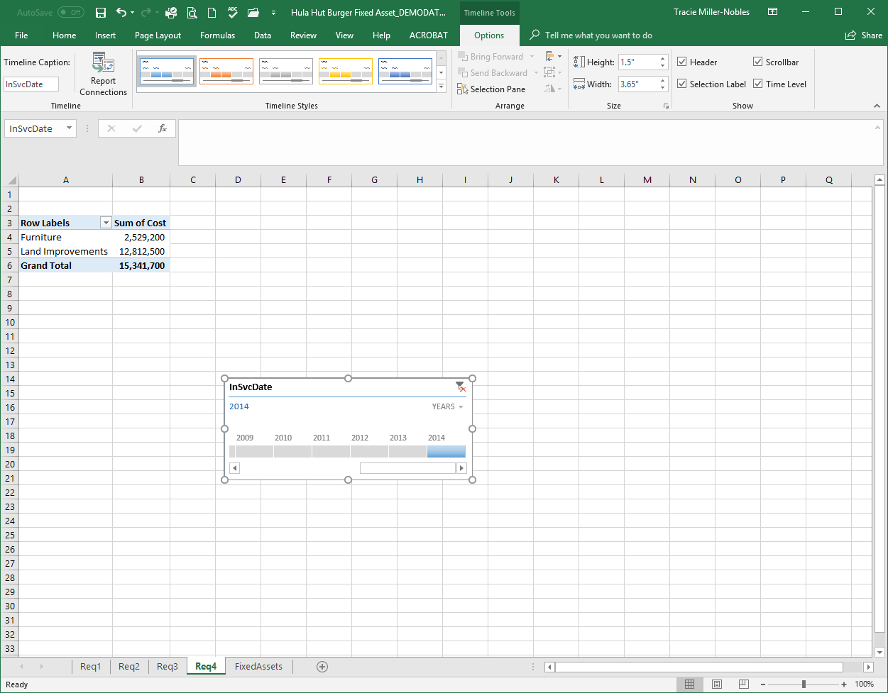
Req 4: Total cost of assets purchased by asset category in 2014
#5: Select 2014 only.

Slide 43
Requirement 5
How much equipment was purchased in the Northeast in 2008? (Hint: Use the Timeline Tool)

Slide 44
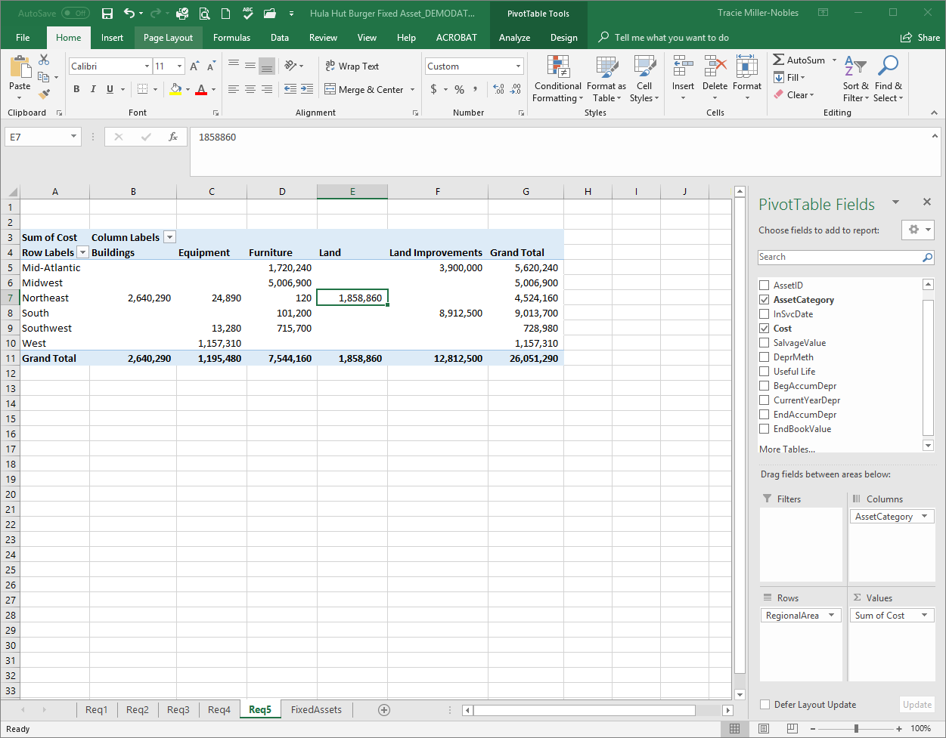
Req 5: Equipment purchased in Northeast in 2008
#1: Begin by creating a pivot table showing the total cost by asset category and regional area.

Slide 45
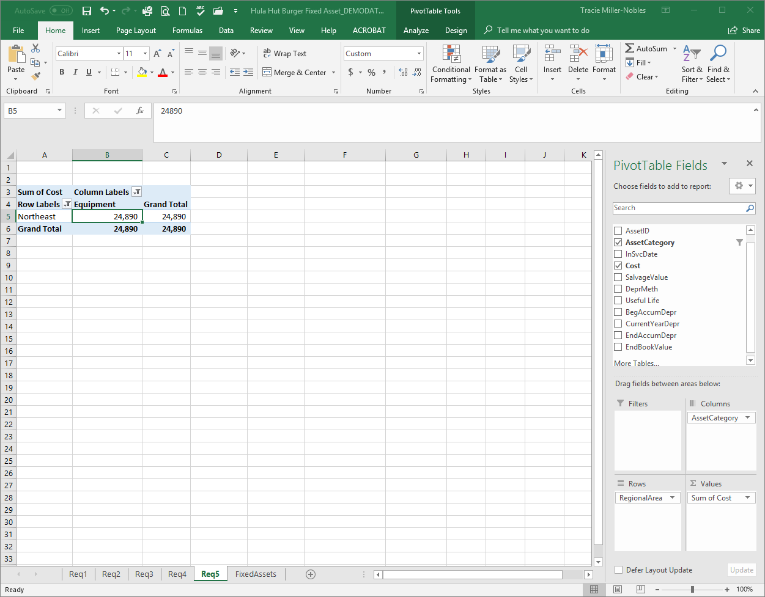
Req 5: Equipment purchased in Northeast in 2008
#2: Sort the rows to show only Northeast and the columns to show only equipment by using the drop down arrows.

Slide 46
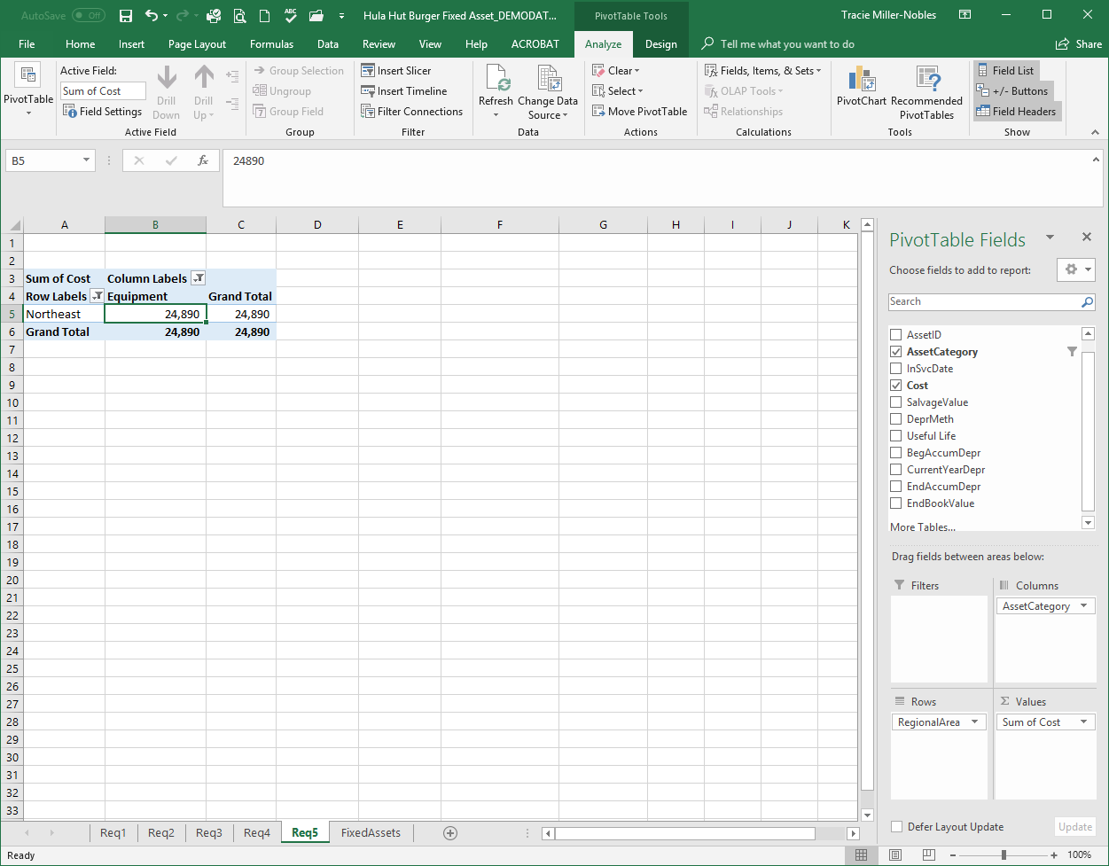
Req 5: Equipment purchased in Northeast in 2008
#3: On the analyze tab, click Insert Timeline

Slide 47
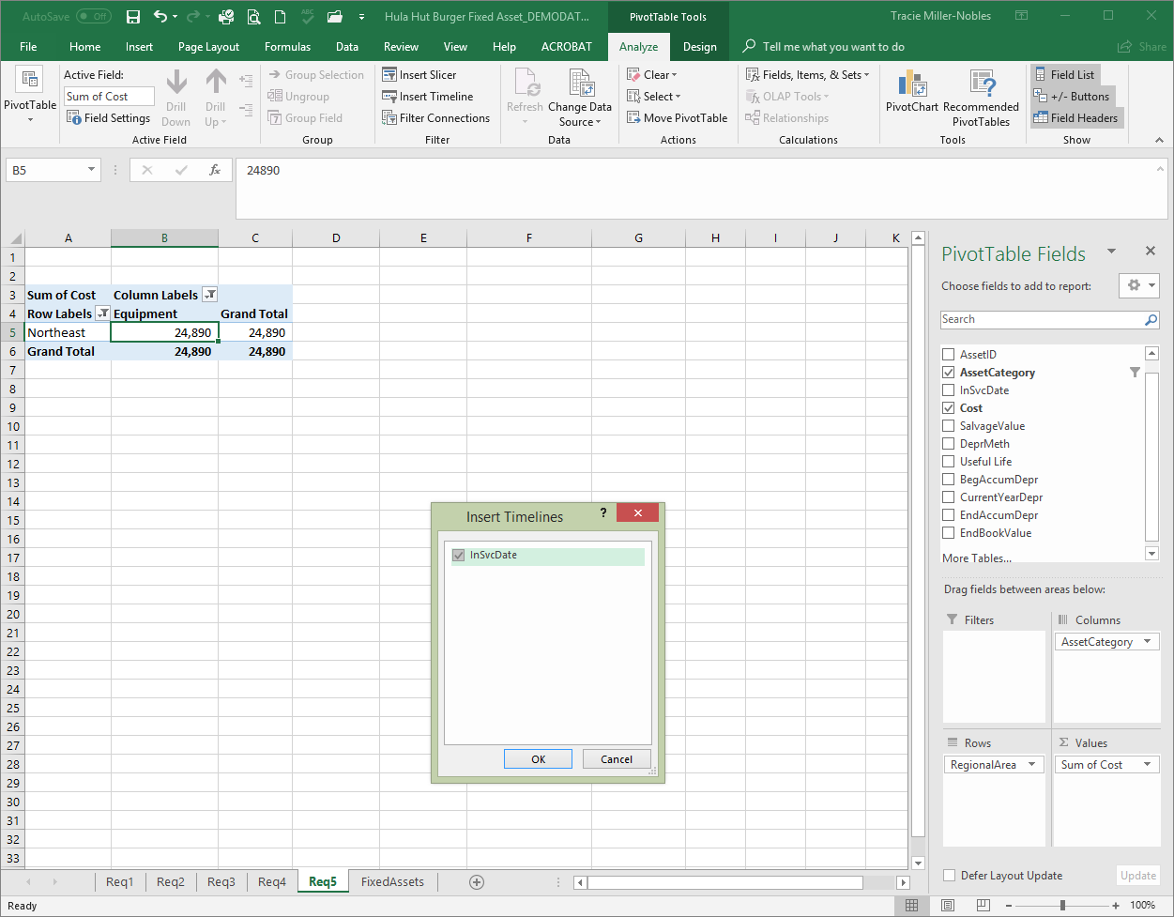
Req 5: Equipment purchased in Northeast in 2008
#4: Select InSvcDate and then OK

Slide 48
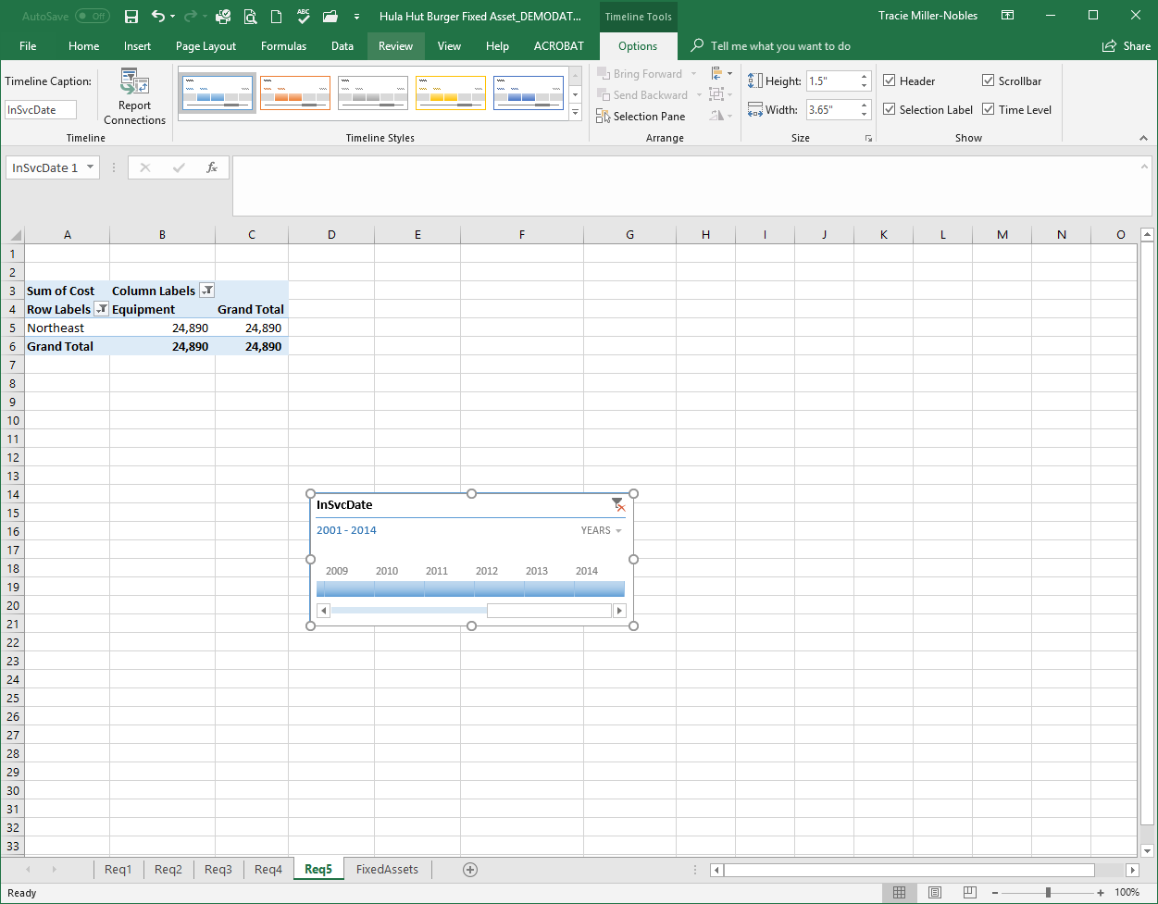
Req 5: Equipment purchased in Northeast in 2008
#5: The default is months. Change to years by clicking on the down arrow and selecting years.

Slide 49
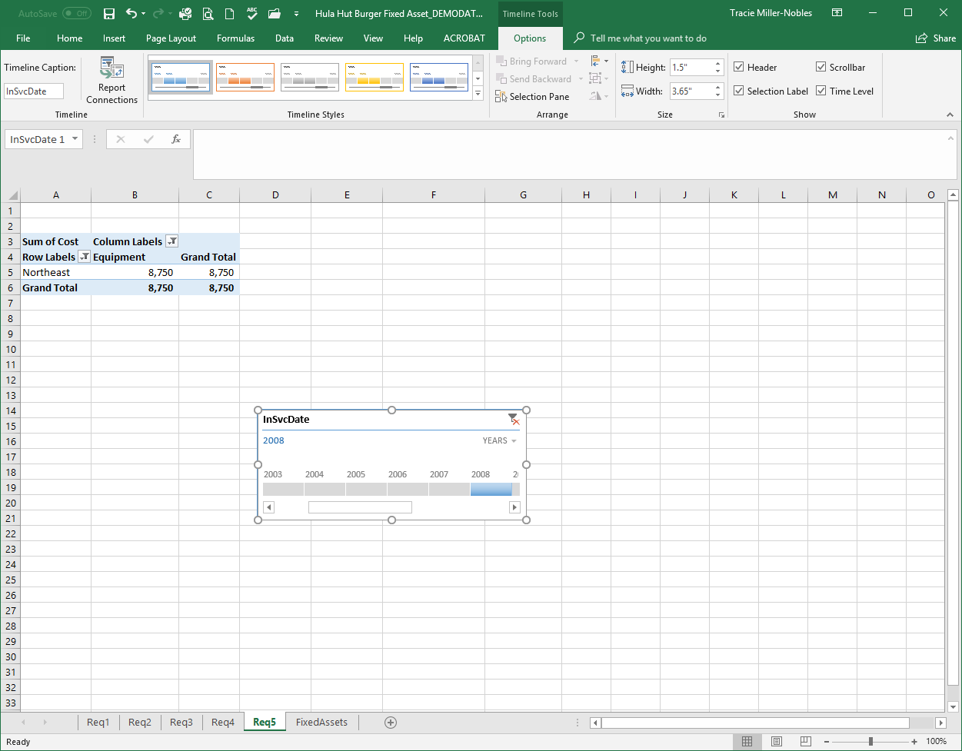
Req 5: Equipment purchased in Northeast in 2008
#6: Select 2008 only.

Slide 50
Requirement 6
What are the total cost of assets purchased by category before 2005? (Hint: Use the Timeline Tool)

Slide 51
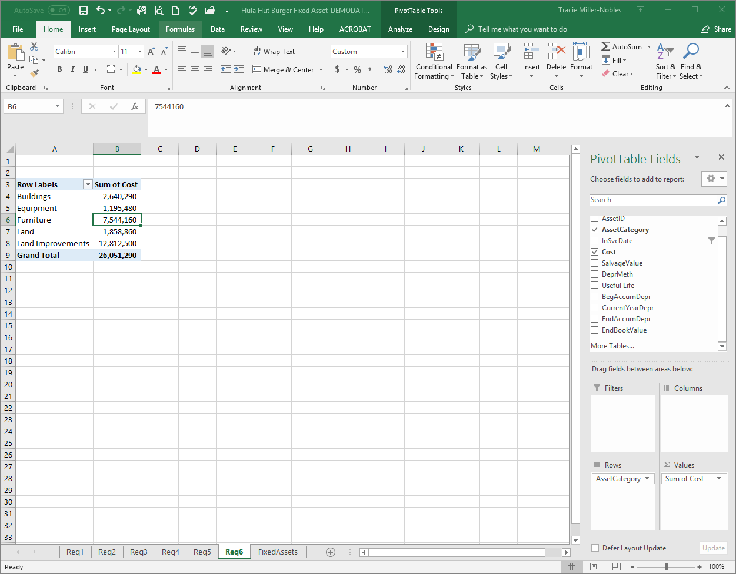
Req 6: Total cost of assets by category before 2005
#1: Begin by creating a pivot table showing the total cost by asset category.

Slide 52
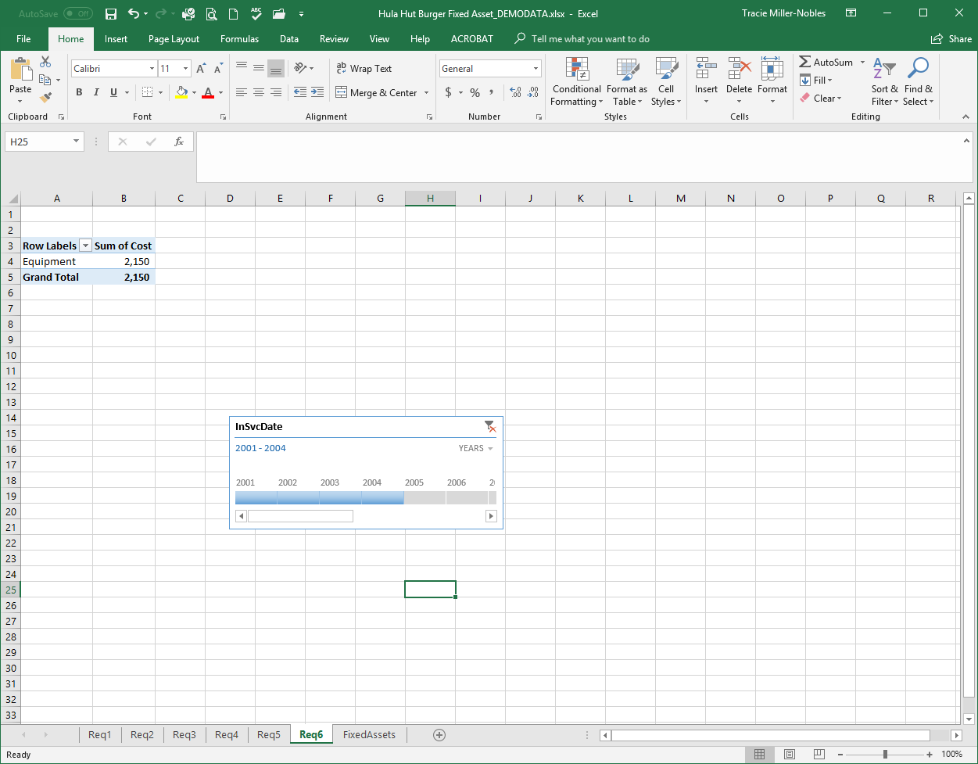
Req 6: Total cost of assets by category before 2005
#2: Insert a timeline and select all years prior to 2005.

Slide 53
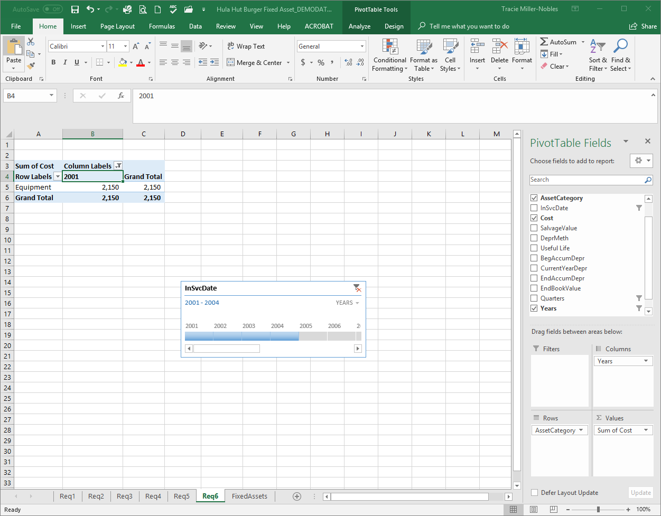
Req 6: Total cost of assets by category before 2005
#3: Double check by dragging “Years” down to columns.

Slide 54
Requirement 7
Prepare a pivot table that shows the book value of the furniture category by region. Prepare a pivot chart using the column chart type for this information.

Slide 55
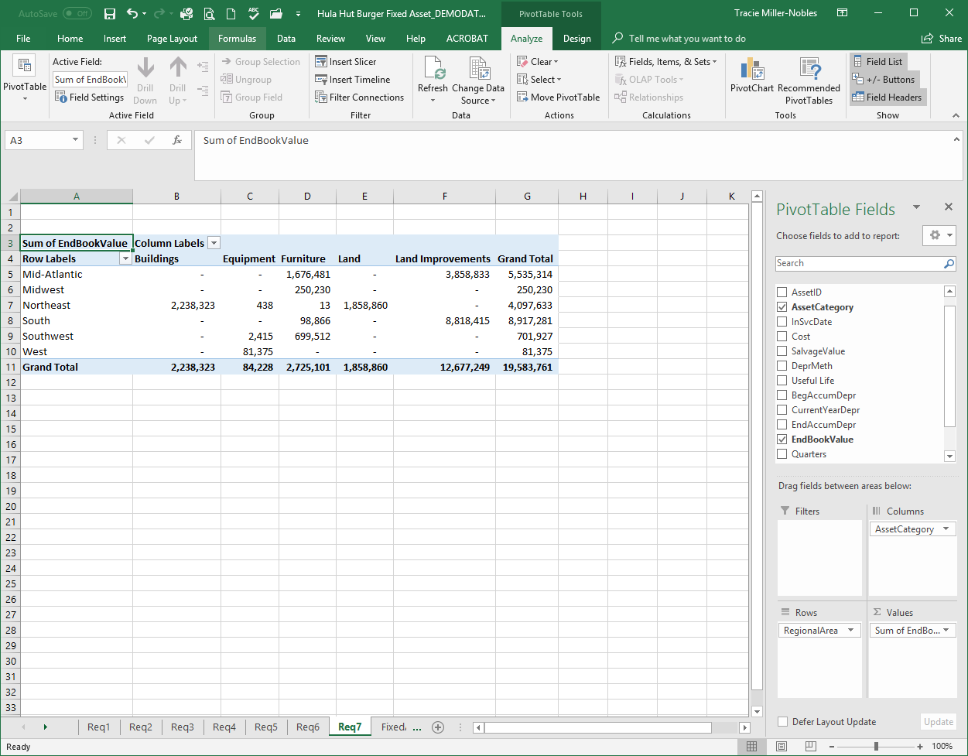
Req 7: Pivot table book value of furniture by region
#1: Begin by creating a pivot table showing the ending book value by asset category and region.

Slide 56
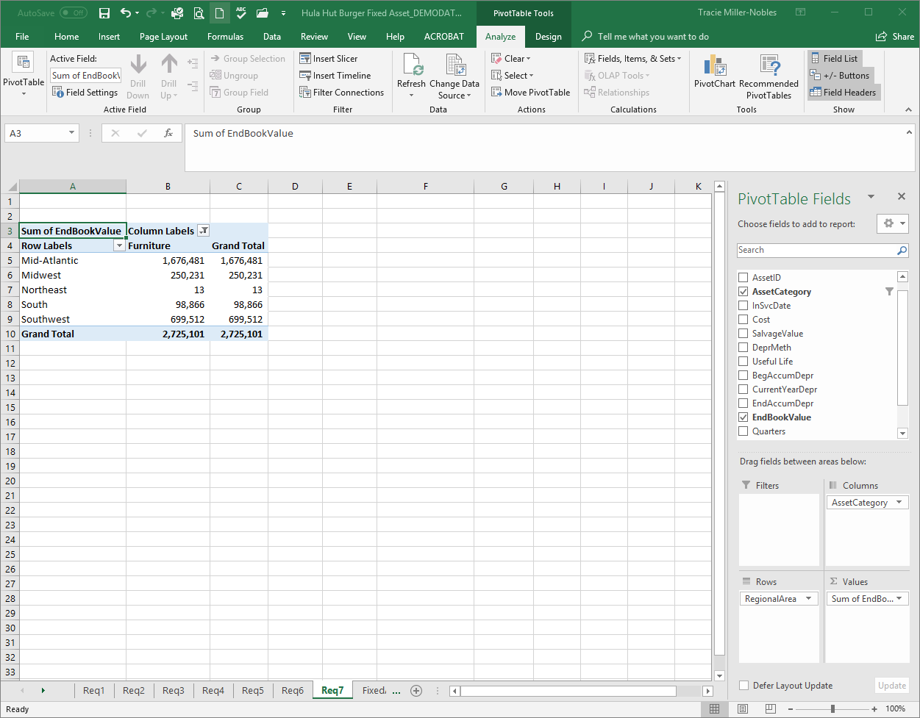
Req 7: Pivot table book value of furniture by region
#2: Use the column labels to show only the furniture.

Slide 57
Req 7: Prepare a pivot chart using column chart.
#3: On the analyze tab, click on PivotChart.

Slide 58
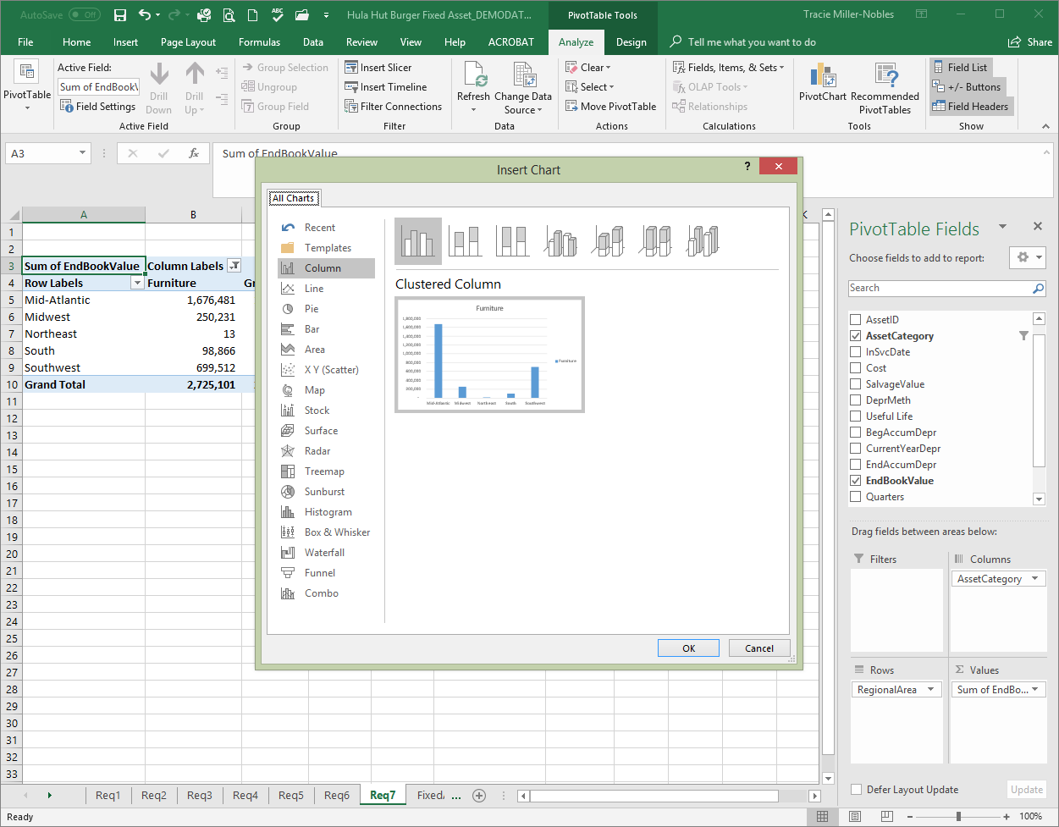
Req 7: Prepare a pivot chart using column chart.
#4: Select Column and Clustered Column. Click OK.

Slide 59
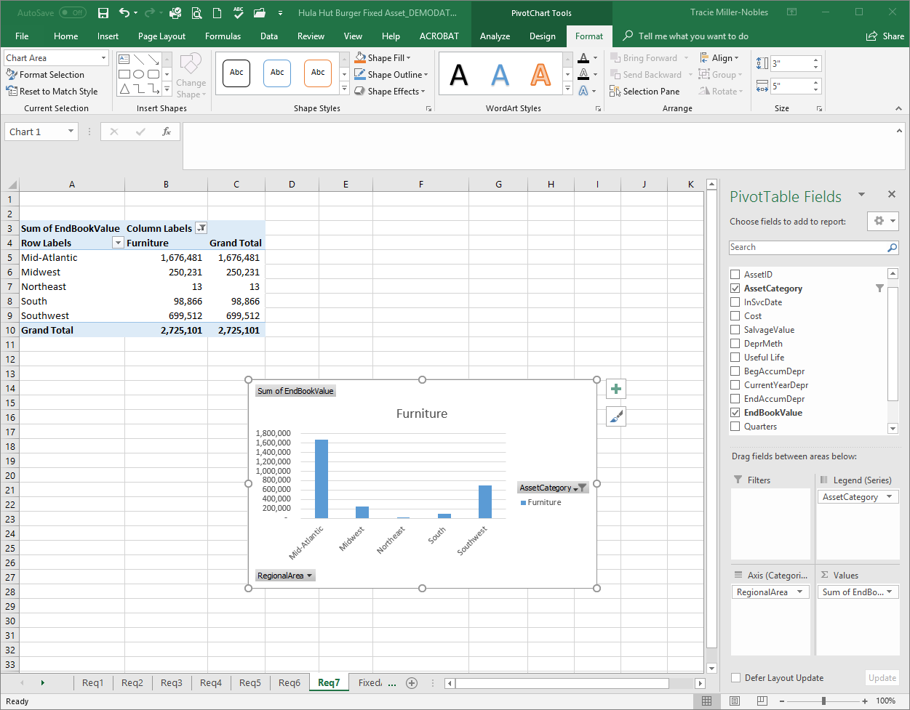
Req 7: Prepare a pivot chart using column chart.
#5: The pivot chart is shown.

